Slide 1
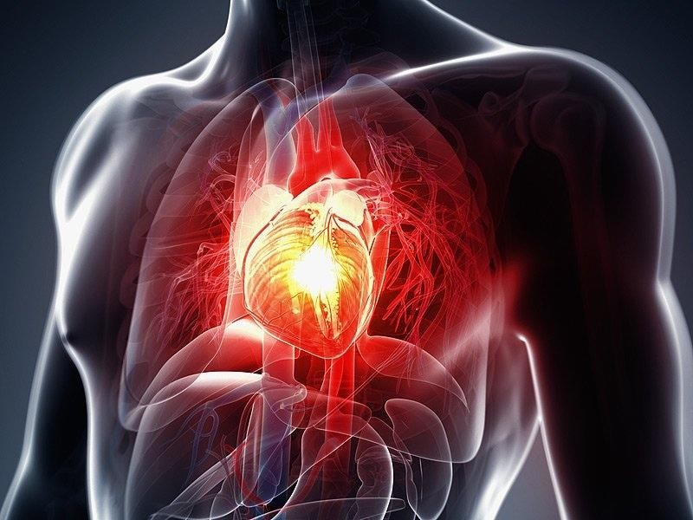
Capstone Project
Cardio Vascular Risk Analysis
Team Members
Sarthak Gupta Lova Kumar Poluparti

Slide 2
Contents
Introduction
Problem Statement
Methodology
Loading the data
Exploratory Data Analysis
Treating missing values and outliers
Feature engineering
Train test split
Data Modeling
Cross validation
Hyper parameter tuning
Conclusion

Slide 3
Introduction
Cardiovascular disease is the term for all types of diseases that affect the heart or blood vessels, including coronary heart disease (clogged arteries), which can cause heart attacks, stroke, congenital heart defects and peripheral artery disease.
Cardiovascular disease is a major health burden worldwide in the 21st century.
Consequently, there is an urgent requirement for early location and treatment of such
diseases.
What are the main causes of coronary heart disease?
Smoking. Smoking is a major risk factor for coronary heart disease.
High blood pressure. High blood pressure (hypertension) puts a strain on your heart and can lead to CHD.
High cholesterol.
High lipoprotein (a)
Lack of regular exercise.
Diabetes.
Machine Learning is one of the slanting innovations utilized in numerous circles far and wide including the medicinal services application for predicting illnesses.
In this project, data of Framingham city is given.
The Framingham Heart Study is a long-term, ongoing cardiovascular cohort study of residents of the city of Framingham, Massachusetts.

Slide 4
Problem Statement
The dataset is from an ongoing cardiovascular study on residents of the town of Framingham, Massachusetts.
The classification goal is to predict whether the patient has a 10-year risk of future
coronary heart disease (CHD).
The dataset provides the patients’ information. It includes over 4,000 records and 15 attributes.
Numerical columns:
id, age, totChol, sysBP, diaBP, BMI, heartRate, glucose Categorical columns:
education, cigsPerDay, sex, is_smoking, BPMeds, prevalentStroke, prevalentHyp, diabetes,
TenYearCHD
Dataset shape: (3390, 17)

Slide 5
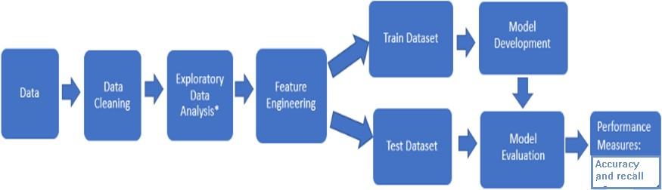
Methodology

Slide 6
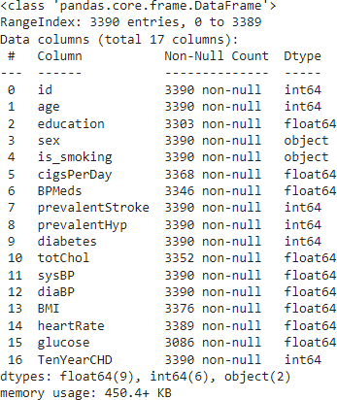
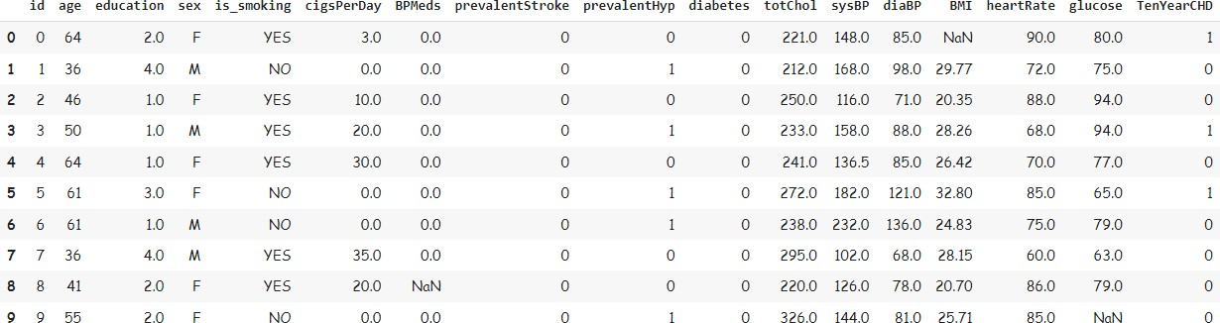
Loading the Dataset
After loading the dataset we can observe that it contains 3390 rows and 17 columns to deal with.
Since we have information of all the
columns, we can proceed EDA

Slide 7
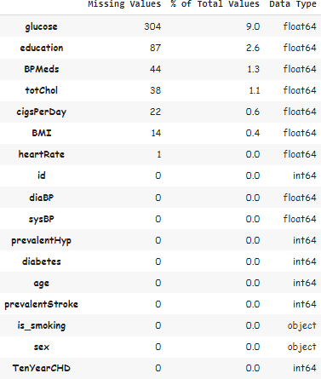
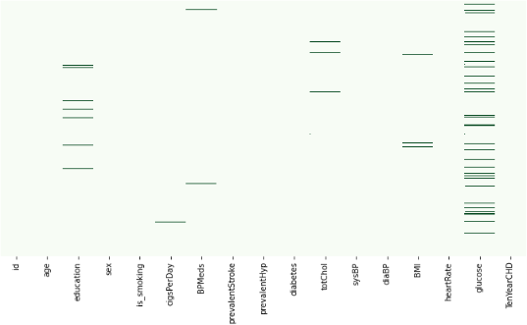
Exploratory Data Analysis
Uni-variate Analysis
Visualization of Missing values

Slide 8
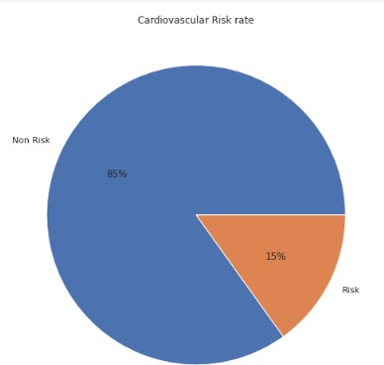
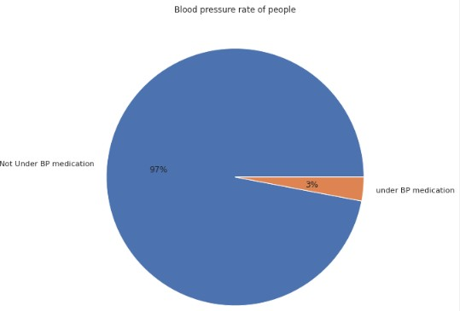
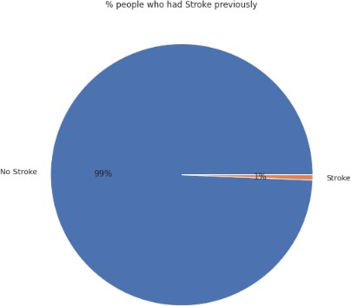
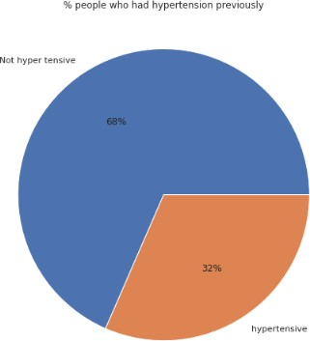
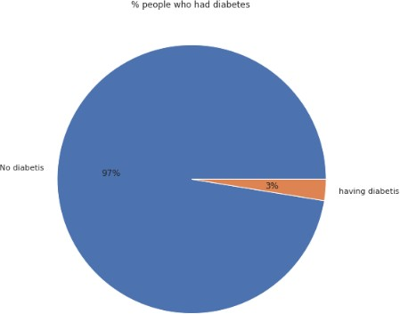
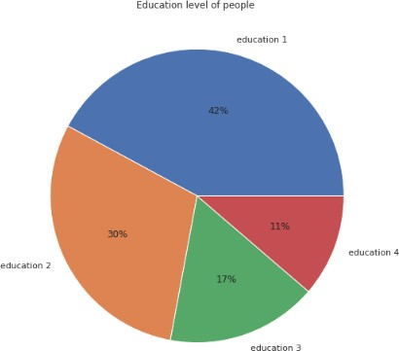
Uni-variate Analysis
EDA
Pie chart to get insight of several columns and it is clear that the data is highly imba

Slide 9
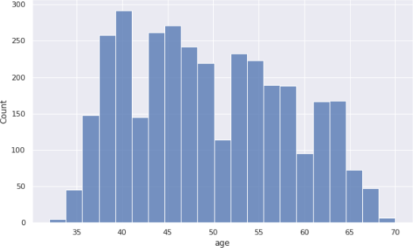
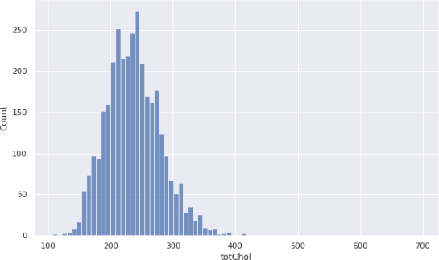
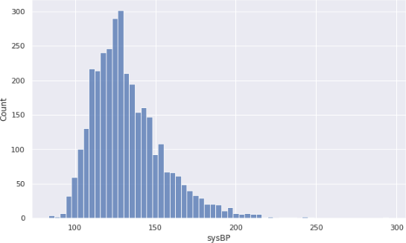
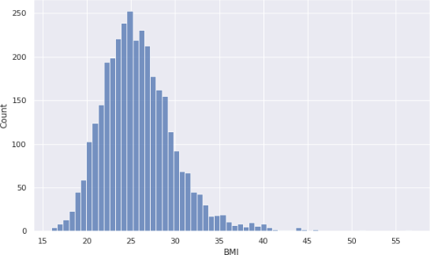
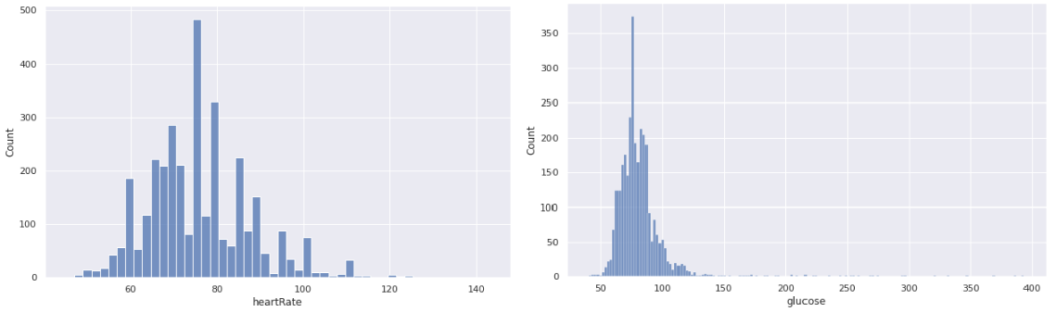
EDA
Bi-variate Analysis
Histogram of several numerical columns

Slide 10
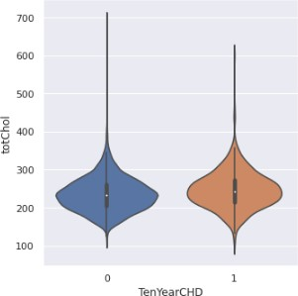
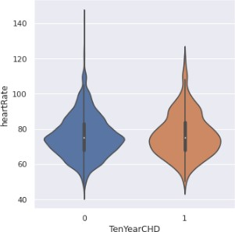
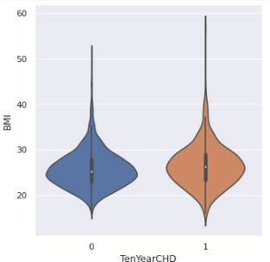
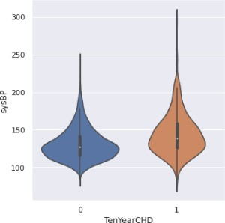
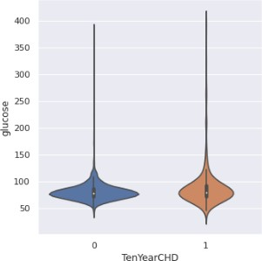
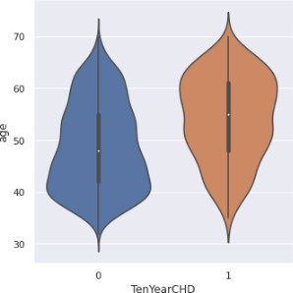
Bi-variate Analysis
EDA
Violin plot for several numerical columns
with
the dependent variable

Slide 11
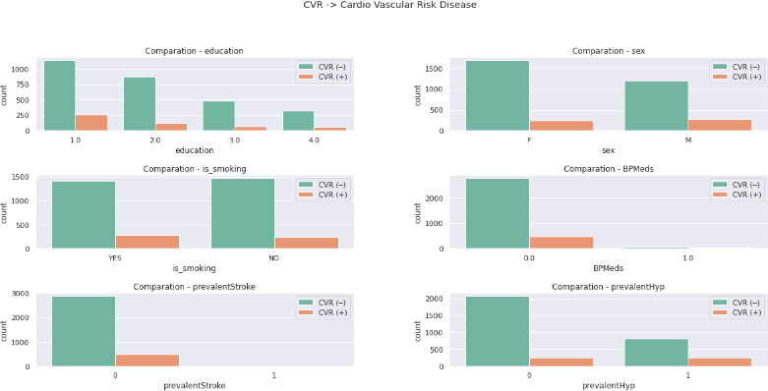
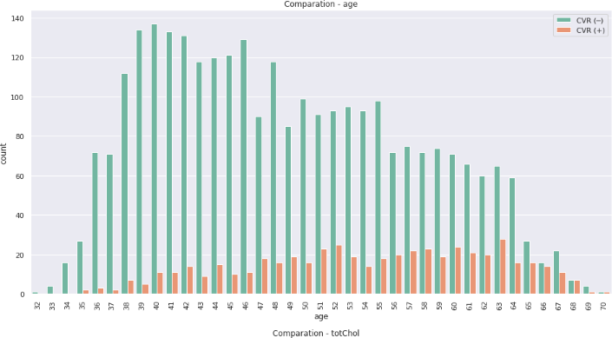
Bi-variate Analysis
EDA
Trying to get some insights about the dependent columns with categorical variables
Age column with the dependent variable

Slide 12
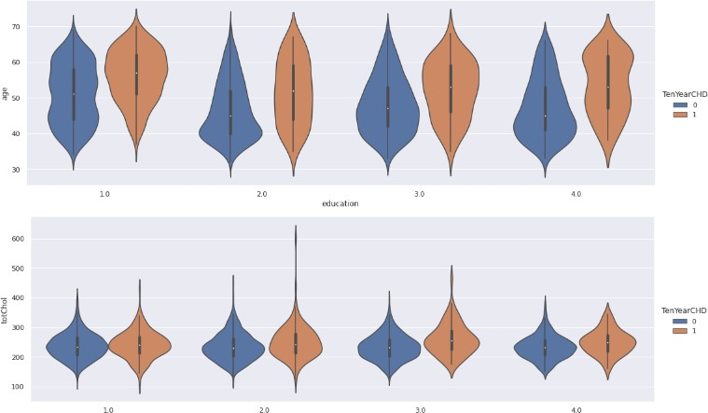
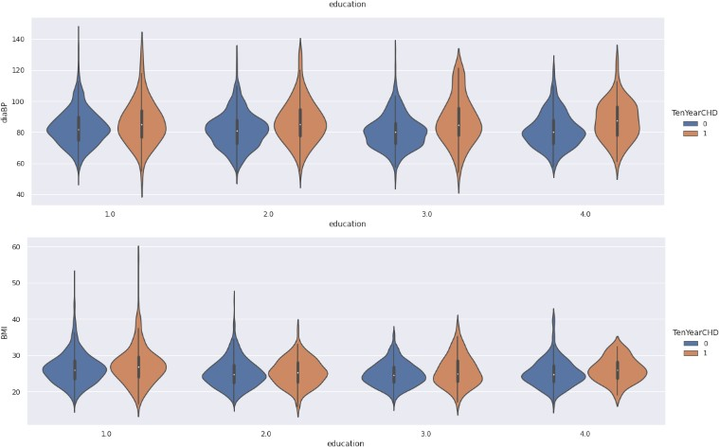
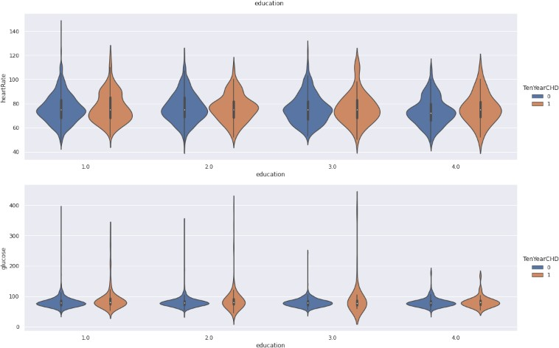
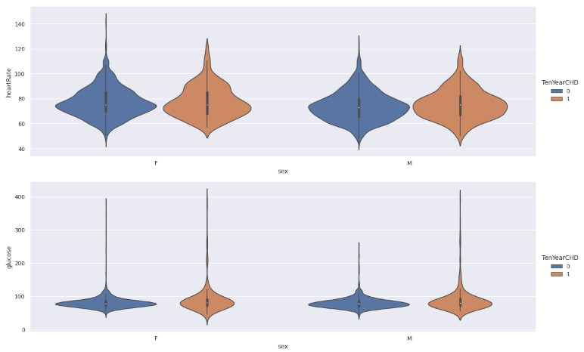
Multi-variate Analysis
EDA
Visualization of numerical columns with the education column along with dependent column

Slide 13
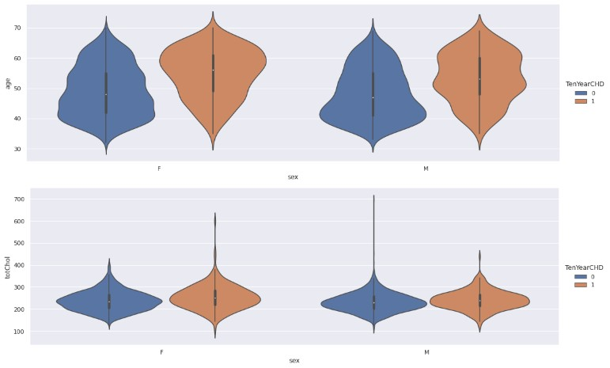
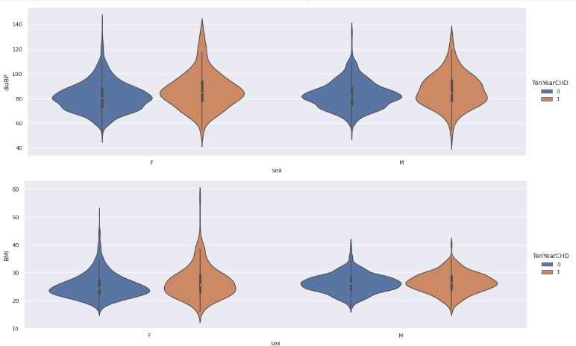
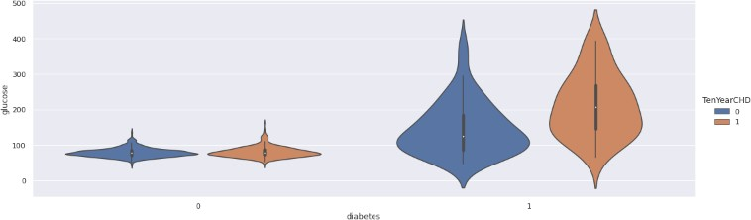
EDA
Multi-variate Analysis
Visualization of numerical columns with the education column along with dependent column

Slide 14
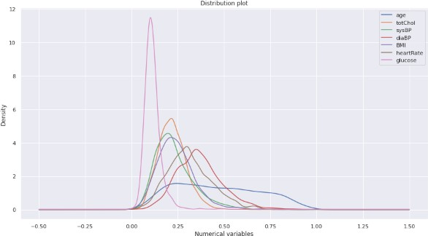
Conclusions of EDA:
EDA
Slightly more males are suffering from CHD than females.
The people who has high BMI are at risk of CHD.
The people with hypertension are at highrisk of CHD.
The percentage of people who have CHD is almost equal between smokers and non smokers.
The uneducated people or the people with basic education are at high risk of CHD compared with well educated.

Slide 15
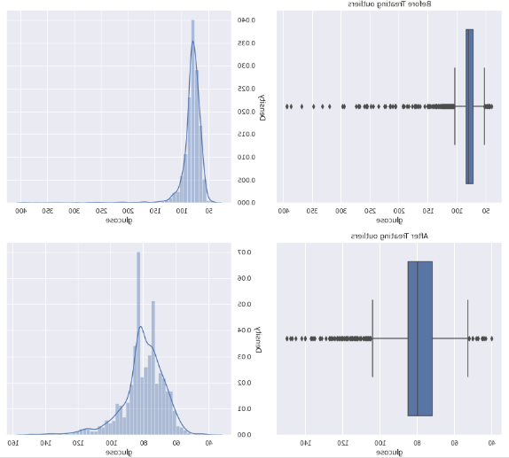
Treatment of Missing Values and Outliers
Treatment of missing values:
There are 6 columns with missing
values.
All the missing values are treated with mean and mode except the ‘glucose’ column.
In glucose column, there are 9% of missing values. So we try dealing with this column from KNN imputation.
Treatment of Outliers :
Outliers treatment in this data set is treated by z score.

Slide 16
Feature Engineering
Feature engineering is the process of selecting, manipulating, and transforming raw data into features that can be used in supervised learning.
Feature Engineering consists of various process :
Feature Creation (2) Transformation (3) Feature Selection
Feature Creation: Creating features involves creating new variables which will be
most helpful for our model.
Transformations: Feature transformation is simply a function that transforms features from one representation to another(Normal distribution). We have used
Box-cox and log transformation to convert columns to Normal distribution.
(1) Feature Selection: Feature extraction is the process of extracting features from a data set to identify useful information. We have used f-regression to do the feature selection.

Slide 17
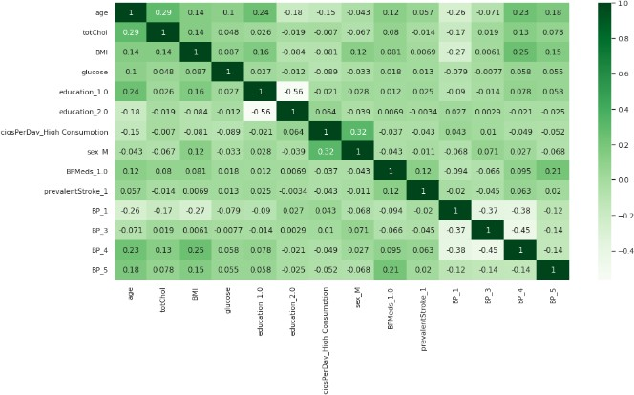
Feature Engineering
After the process of feature creation, feature transformation and feature selection, we use the one hot encoding to encode all categorical variables.
Later we carry out the standardization technique of minmax scaler to normalize the data.
Now we are all set with the dataset, so at last we check the multicollinearity of the columns. We keep only those columns which are having less or no correlation.

Slide 18
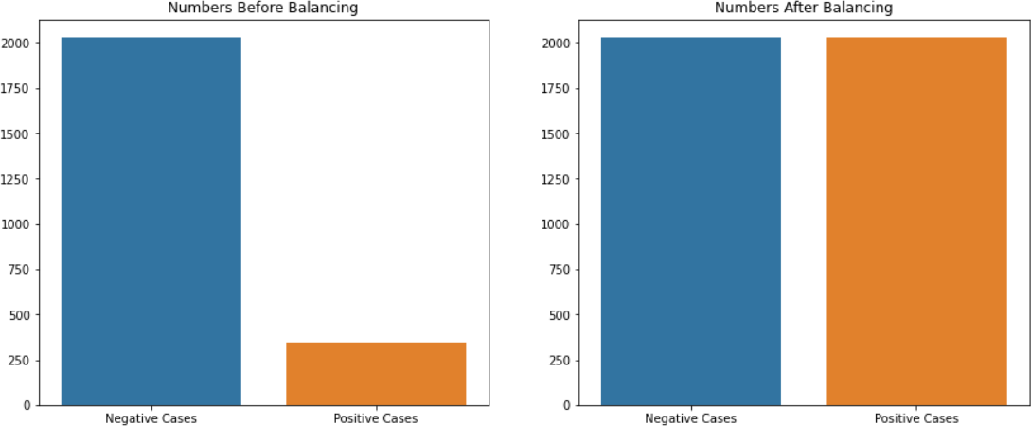
Data Balancing using Smote Model
Shape
trained_dataset shape before smote: 2373
Resampled Tained_dataset shape: 4056
Number of values for class 1&0: Before smote: {0: 2028, 1: 345}
After smote:{0: 2028, 1: 2028}

Slide 19
Building model
Before building the models, we perform the train test split. We have taken 70% of the data as train data and 30% of the data as test data.
There are many classification models available in supervised machine learning. The
models which we have used are,
Logistic regression
Decision Tree
Random Forest
K – nearest neighbor
Naïve Baye’s
Adaboost
Support Vector Machine (SVM)

Slide 20
Classification Models
Logistic regression : Logistic regression is a process of modeling the probability of a
discrete outcome given an input variable.
Decision Tree : A decision tree is a mechanical way to make a decision by dividing the inputs into smaller decisions. The tree is divided into decision nodes and leafs. It is based on the concept of entropy.
Random Forest : Random forests or random decision forests are an ensemble learning method for classification, regression and other tasks that operates by constructing a multitude of decision tree at training time.
K – nearest neighbor : K-NN algorithm stores all the available data and classifies a
new data point based on the similarity. This means when new data appears then it can be easily classified into a well suite category by using K- NN algorithm.

Slide 21
Classification Models
5. Naïve Bayes classifiers : Naïve Bayes classifiers are a family of simple “probabilistic clasifiers” based on applying Bayes theorem with strong independence assumptions between the features.
6. Adaboost classifiers : An AdaBoost classifier is a meta-estimator that begins by fitting a classifier on the original dataset and then fits additional copies of the classifier on the same dataset but where the weights of incorrectly classified instances are adjusted such that subsequent classifiers focus more on difficult cases.
7.Support Vector Machine (SVM) : “Support Vector Machine” (SVM) is a supervised machine learning algorithm that can be used for both classification or regression challenges. Here we plot each data item as a point in n-dimensional space with the value of each feature being the value of a particular coordinate. Then, we perform classification by finding the hyper-plane that differentiates the two classes very well.

Slide 22
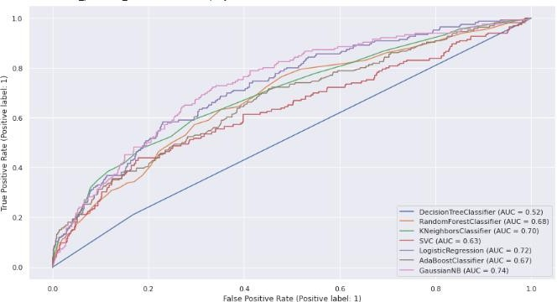
ROC of all models

Slide 23
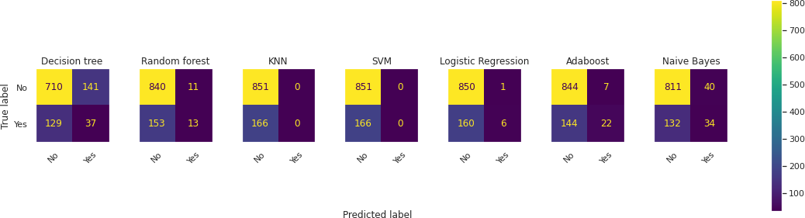
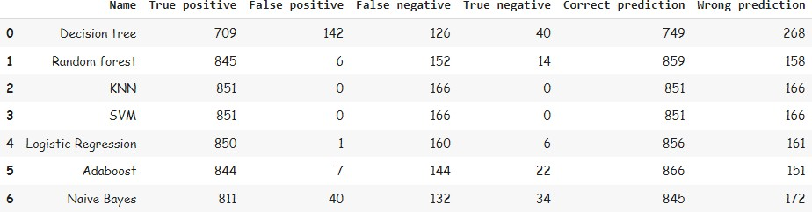
Confusion Metric of all models

Slide 24
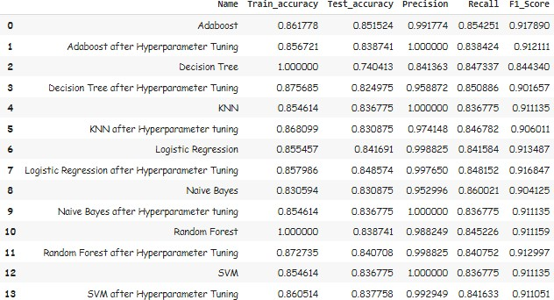
Hyper Parameter Tuning
After building models, we try to improve the performance of the models by
hyper parameter tuning.
This is the evaluation metric of all models before and after hyper parameter tuning.

Slide 25
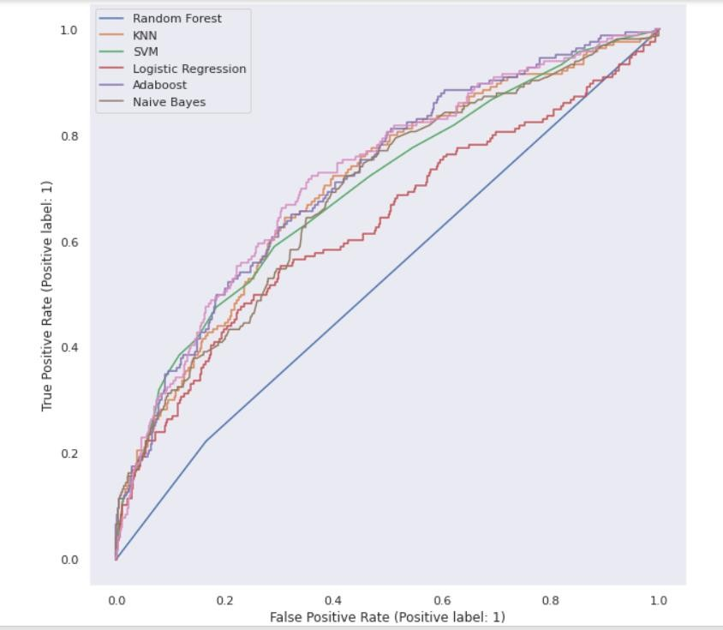
ROC of all the models after Hyperparameter Tuning

Slide 26
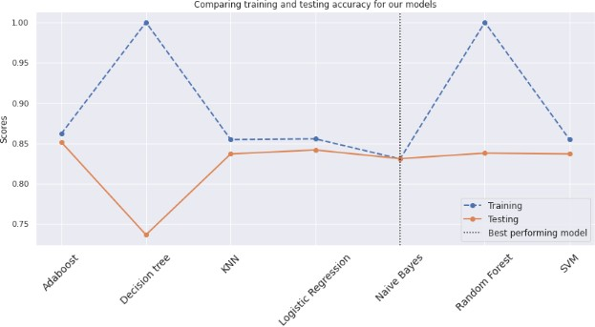
Model performance of all models after Hyper parameter tuning

Slide 27
Conclusion
Here after going through the evaluation metric, we can observe that,
To evaluate the model performance, we consider accuracy and recall.
Random Forest, Adaboost and Naïve Bayes are the models which are having high values of recall.
But if we consider accuracy, Random Forest is overfitting. So Adaboost and Naïve
Bayes are the models which are performing good.
Among Adaboost and Naïve Bayes, Naïve Bayes is the best performer.

Slide 28
Challenges faced
The dependent variable has very few data labeled as ‘1’. So we can observe in all models that precision is more. As the models did not had much of two classes ‘0’ and ‘1’ to learn from the data, the models are failing to predict the data as ‘1’.
Due to this class imbalance, several models are overfitting. Even though we have treated the class imbalance, we could not come over it. We were only able to reduce it.
References
Analytics Vidhya
GeeksforGeeks
Medium

Slide 29
Thank You

